Slide 1
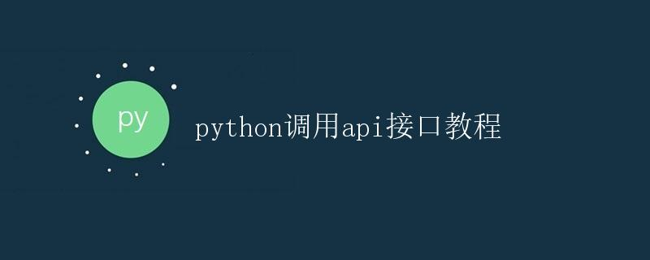
Python API Calling Tutorial

Slide 2
1. Introduction
This tutorial will help you understand how to call APIs in Python. An API (Application Programming Interface) is a software implementation that allows different applications to communicate with each other. Using APIs, you can integrate different functionalities into your applications, thereby improving development efficiency and resource utilization.
In this tutorial, we will show you how to use Python's requests library to send HTTP requests and access public APIs to retrieve data. We will also learn how to process the data returned by the API and how to control the API's behavior by setting parameters.

Slide 3
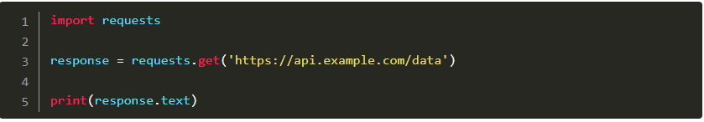
2. Send a GET request
A GET request is a common HTTP request method for retrieving data from a server. For public API interfaces, we can use GET requests to obtain data.
In Python, the requests library can be used to send GET requests. First, we need to install the requests library, which can be done using the following command:
After installation, we can import the requests library into our Python scripts and then use the requests.get() method to send GET requests. Below is a simple example code:
In the example above, we sent a GET request to https://api.example.com/data and stored the returned response in the variable `response.text`. The returned data can be retrieved using `response.text`.

Slide 4
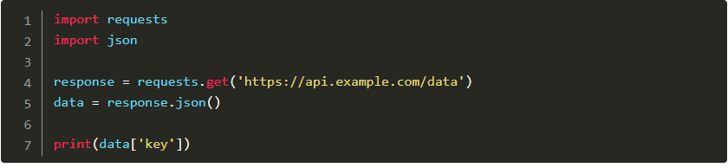
3. Process the data returned by the API.
Data returned by API interfaces is typically organized in JSON format. JSON (JavaScript Object Notation) is a commonly used data exchange format, characterized by its readability and ease of parsing.
In Python, the `json` library can be used to parse JSON data. We can use the `json.loads()` method to convert a JSON string into a Python object, which can then be easily manipulated and accessed.
Below is a sample code example for processing JSON data returned by an API:
In the example above, we first send a GET request using the requests.get() method and convert the returned response into JSON format data, storing it in the data variable. Then, we can access specific fields in the returned data through data['key'].

Slide 5
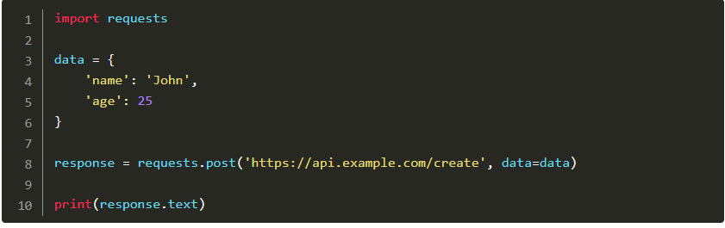
4. Send a POST request
Besides GET requests, we can also use POST requests to submit data to API interfaces. POST requests are typically used to create or modify resources on a server.
In Python, we can use the `requests.post()` method to send a POST request, passing the data to be sent via the `data` parameter. Below is an example code:
In the example above, we first defined the data to be sent, including name and age. Then, we used the `requests.post()` method to send a POST request, passing the data via the `data` parameter. The returned result can be retrieved using `response.text`.

Slide 6
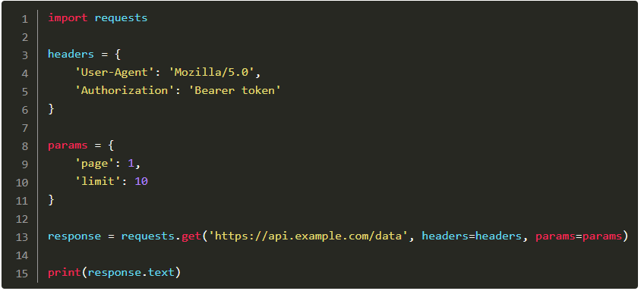
5. Set request headers and parameters
In practical applications, we may need to set request headers and parameters to control API behavior. Request headers are used to pass additional information, such as authentication information and user agents. Parameters are used to control API behavior, such as pagination, sorting, and filtering.
In Python, you can use the `headers` parameter from the `requests` library to set request headers and the `params` parameter to set parameters. Below is an example code:
In the example above, we first defined the request headers and parameters. Then, we passed the request headers and parameters through the `headers` and `params` parameters in the `requests.get()` method. Different request headers and parameters can be set according to actual needs.

Slide 7
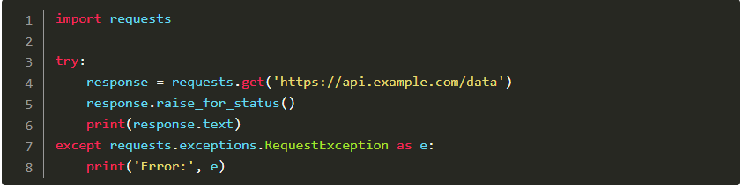
6. Error Handling
When using API interfaces, we need to consider error handling. Common errors include network connection errors, request timeouts, and server errors.
In Python, the try-except statement can be used to catch and handle exceptions. Below is an example code:
In the example above, we first send a GET request and use the `response.raise_for_status()` method to check if the returned response is normal. If an error occurs, a `requests.exceptions.RequestException` will be thrown, which can be caught and handled using an `except` statement.

Slide 8
7. Summary
This tutorial introduces how to call API interfaces in Python. We learned how to send GET and POST requests and how to process the data returned by the API. We also learned how to set request headers and parameters, and how to handle errors.

